Slide 1
My Perimeter, Area and Volume Interactive Notebook
Name
Class
Term 3 Semester 2

Slide 2
Contents
Formula Page
Page
Date
Description
2
3

Slide 3
Tasks
24
7
30
Essential Question
Questions
Notes
Summary
10
11

Slide 4
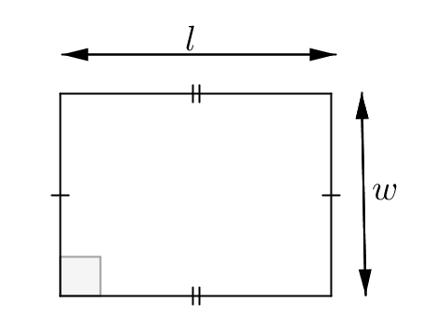
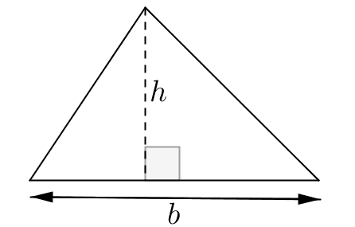
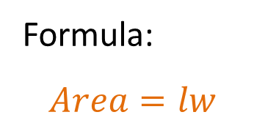
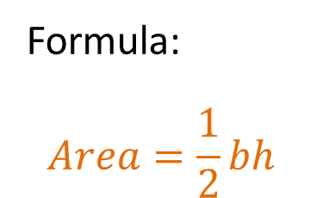
24
7
30
Date
Area
EQ – Describe how the formula for a rectangle and triangle are used to find the area of other quadrilaterals
Formula:
$$Area=lw$$
Formula:
$$Area=\frac{1}{2}bh$$
11

Slide 5
Task
Complete the formula sheet for the quadrilaterials

Slide 6
Notes Review
24, 7 ,30
Date
Title
Essential question
Notes complete
Notes complete with colour and diagrams
Questions completed
Contents page filed in
Formula page filled in

Slide 7
Homework
Review your notes and write a summary answering the essential question.

